Slide 1
Cyber Insurance
Worth the Effort or Total Rip-Off?
Inga Goddijn
EVP & Managing Director
inga@riskbasedsecurity.com

Slide 2
Welcome!
What is “Cyber” insurance anyway?
What can this policy do for us?
The things companies won’t pay for, even if it looks like they will in the brochure.
Why are they asking me this silly question and does this mean we have to change how we’re doing things?

Slide 3

Is there any industry with a worse reputation?

Slide 4
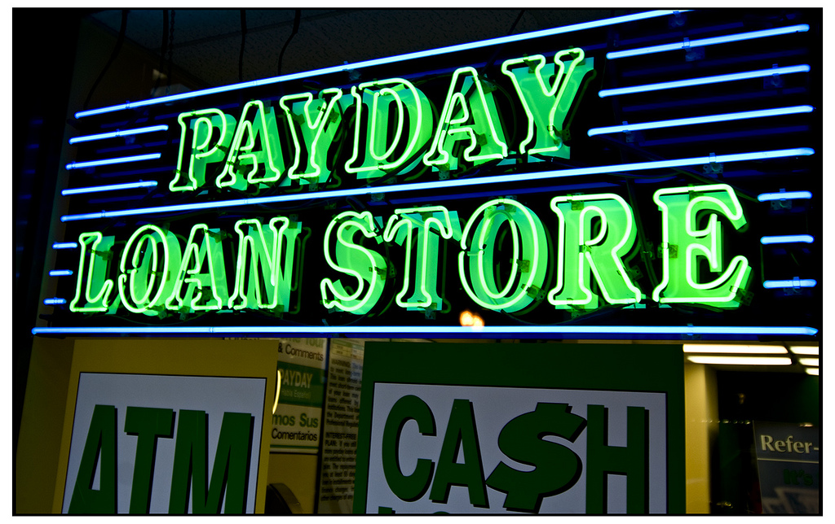

Worse Reputation?

Slide 5




Worse Reputation?

Slide 6
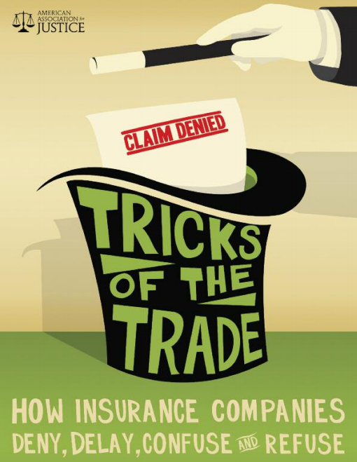
But is it well deserved?
From the American Association for Justice

Slide 7

Reality of Risk
Perfect Security?

Slide 8
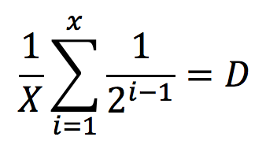
Reality of Risk
Law of Diminishing Returns

Slide 9

Reality of Risk
How are we responsible for this?

Slide 10
Reality of Risk
Risk
Acceptance
Transfer
Avoidance
Limit

Slide 11
Reality of Risk
Accept
High level of certainty around the impact
Avoid
Not always possible
Limit
Controls are key, but…

Slide 12
Transfer!
Transfer Options
Outsourcing
Contracts & Agreements
Insurance

Slide 13

What’s in a name?
Network Security Data Breach
Data Privacy Security Liability
Network Protection Data Security

Slide 14



Cyber Insurance

Slide 15
Cyber Insurance
First Party
Pays to fix the things
we own when
damaged
Third Party
Pays others when our actions (or inaction) causes harm
As a result of a security event including data compromise

Slide 16


Cyber Insurance
Third Party
First Party
Michael Jastremski

Slide 17
Cyber Insurance
Why does this matter?
Because it means organizations can buy a policy that can cover both
Security event recovery costs
&
Protection from lawsuits arising out of a data compromise

Slide 18
Cyber Insurance
Unauthorized Access
Denial of Service
Malware

Slide 19
Cyber Insurance
Breach Notice Compliance
Liability
Forensics
Legal fees
Mailings
Identity protection
Defense costs
Settlements
Responding to regulatory investigations

Slide 20


Cyber Insurance
Marxchivist
Notes:
That first party ‘breach response’ alone is hugely valuable. 47 states, DC, PR, event the US VI require notice to individuals when personal information is compromised – even if there is ZERO discernable harm from the incident. Simply the fact that the information has been, or could reasonable be (i.e. lost lap top), taken, data owners are obligated to let people know.

Slide 21
Cyber Insurance
Forensics$250+
an hour
Lawyers$350+
an hour
Mailing$2-$3 per letter
Identity Protection $25+ per person
Public Relations $150+
an hour

Slide 22


Cyber Insurance
Lawsuits from data breaches can
go on for years.
Privacy & security is a topic of interest among both state and federal agencies.

Slide 23

Cyber Insurance
The secret value rarely discussed

Slide 24
Cyber Insurance
Security Event
Data Recovery &
Re-creation
System Restoration
Extortion Costs
Business Interruption &
Extra Expense

Slide 25

Cyber Insurance
As helpful as some of these policies can be, expect some things not to be covered

Slide 26

Cyber Insurance
Reputation Damage
Michael Jastremski

Slide 27

Cyber Insurance
Reputation damage
Int
Regular maintenance Upgrades Fixes

Slide 28


Cyber Insurance
The economic value of data
Data or systems in the care, custody or control of others

Slide 29
Cyber Insurance
Despite the limitations, there is real value found in these policies.
Especially since these can cost less than
$5,000

Slide 30

Cyber Insurance
Where can we find this?

Slide 31
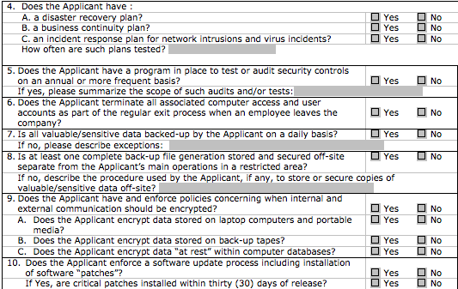
Cyber Insurance
Applications can run up to 12 pages and require input from multiple departments

Slide 32
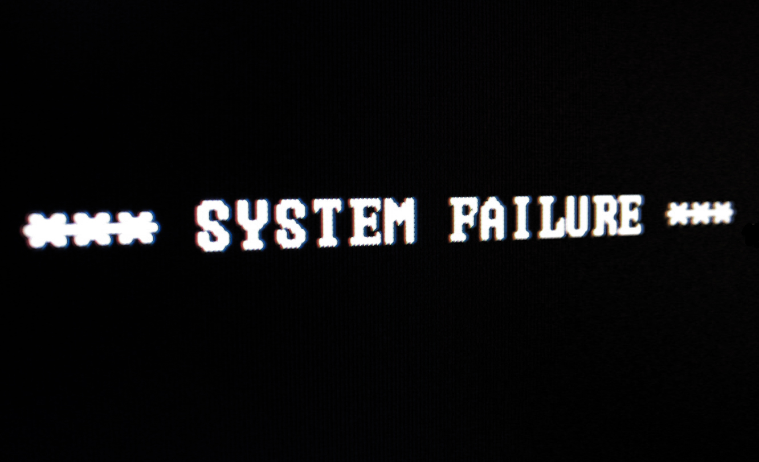
Cyber Insurance
Moral Hazard?

Slide 33

Cyber Insurance
Could insurance force
uniform standards for all?

Slide 34
Cyber Insurance
Benefit to the organization
Cost effective
Readily available
Minimal impact on day-to-day operations
What more could we ask for??

Slide 35

Questions?
THANK YOU

